Slide 1
13
The Peripheral Nervous System and Reflex Activity: Part C

Slide 2
Spinal Nerves
31 pairs of mixed nerves named for point of issue from spinal cord
  Supply all body parts but head and part of neck
  8 cervical (C₁–C₈)
  12 thoracic (T₁–T₁₂)
  5 Lumbar (L₁–L₅)
  5 Sacral (S₁–S₅)
  1 Coccygeal (C₀)

Slide 3
Spinal Nerves
Only 7 cervical vertebrae, yet 8 pairs cervical spinal nerves
  7 exit vertebral canal superior to vertebrae for which named
  1 exits canal inferior to C₇
Other vertebrae exit inferior to vertebra for which named

Slide 4
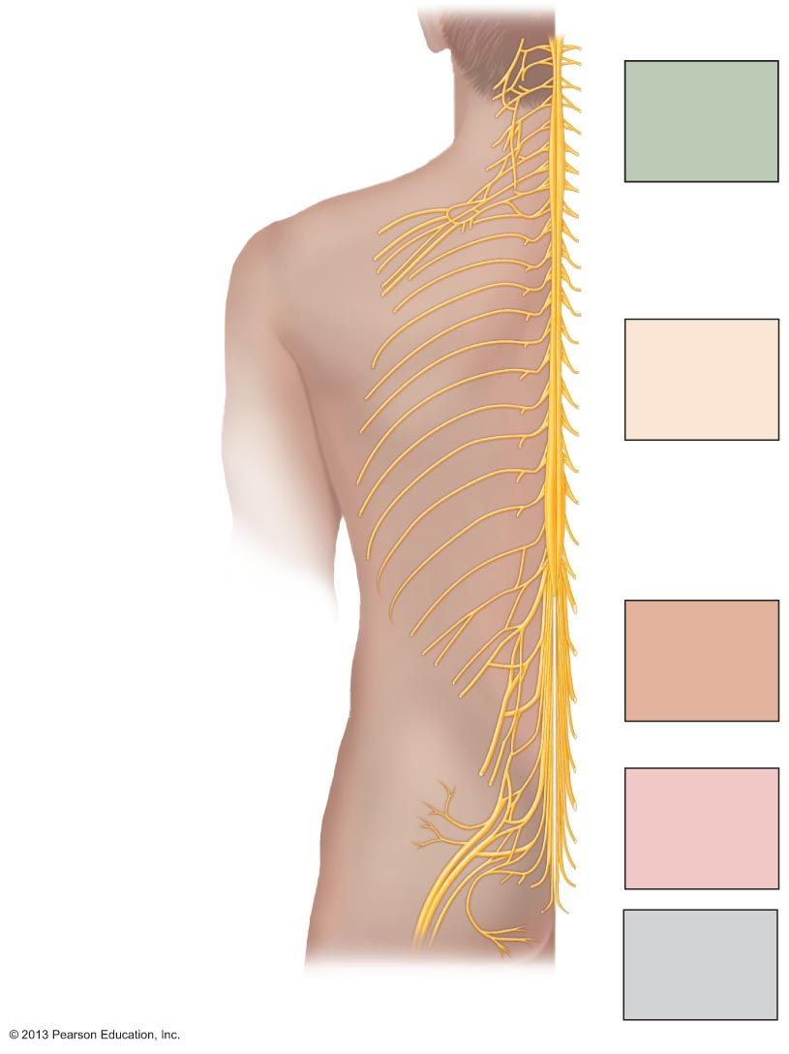
Figure 13.7 Spinal nerves.
Cervical plexus
Cervical
nerves
C₁ – C₈
Brachial plexus
Cervical
enlargement
Intercostal
nerves
Thoracic
nerves
T₁ – T₁₂
Lumbar
enlargement
Lumbar plexus
Lumbar
nerves
L₁ – L₅
Sacral plexus
Sacral
nerves
S₁ – S₅
Cauda equina
Coccygeal
nerve
Co₁

Slide 5
Spinal Nerves: Roots
Each spinal nerve connects to spinal cord via two roots
Ventral roots
  Contain motor (efferent) fibers from ventral horn motor neurons
  Fibers innervate skeletal muscles

Slide 6
Spinal Nerves: Roots
Dorsal roots
  Contain sensory (afferent) fibers from sensory neurons in dorsal root ganglia and conduct impulses from peripheral receptors
Dorsal and ventral roots unite to form spinal nerves, which emerge from vertebral column via intervertebral foramina

Slide 7
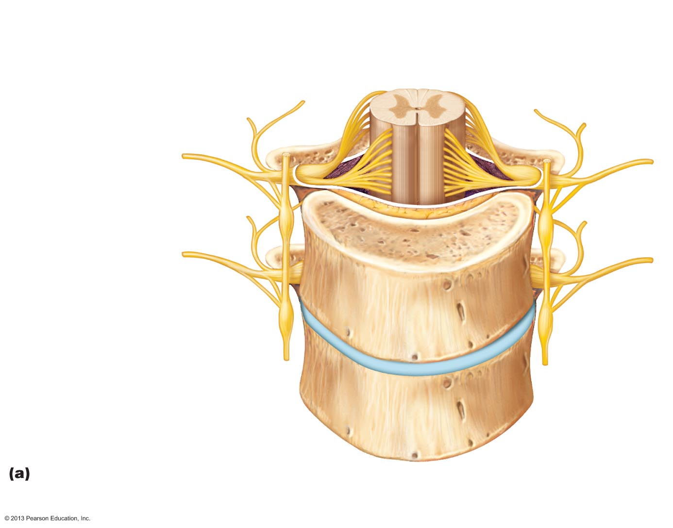
Figure 13.8a Formation of spinal nerves and rami distribution.
Gray matter
White matter
Ventral root
Dorsal and ventral
rootlets of spinal
nerve
Dorsal root
Dorsal root
ganglion
Dorsal ramus
of spinal nerve
Ventral ramus
of spinal nerve
Spinal nerve
Rami communicantes
Sympathetic trunk
ganglion
Anterior view showing spinal cord, associated nerves, and vertebrae.
The dorsal and ventral roots arise medially as rootlets and join laterally to
form the spinal nerve.

Slide 8
Spinal Nerves: Rami
Spinal nerves quite short (~1-2 cm)
Each branches into mixed rami
  Dorsal ramus
  Ventral ramus - larger
  Meningeal branch – tiny, reenters vertebral canal, innervates meninges and blood vessels
  Rami communicantes (autonomic pathways) join ventral rami in thoracic region

Slide 9
Spinal Nerves: Rami
All ventral rami except T₂–T₁₂ form interlacing nerve networks called nerve plexuses (cervical, brachial, lumbar, and sacral)
Back innervated by dorsal rami via several branches
Ventral rami of T₂–T₁₂ as intercostal nerves supply muscles of ribs, anterolateral thorax, and abdominal wall
Spinal roots longer as move inferiorly in cord
  Lumbar and sacral roots extend as cauda equina

Slide 10
Spinal Nerves: Plexuses
Within plexus fibers criss-cross
  Each branch contains fibers from several spinal nerves
  Fibers from ventral ramus go to body periphery via several routes
    Each limb muscle innervated by more than one spinal nerve
      Damage to one does not → paralysis

Slide 11
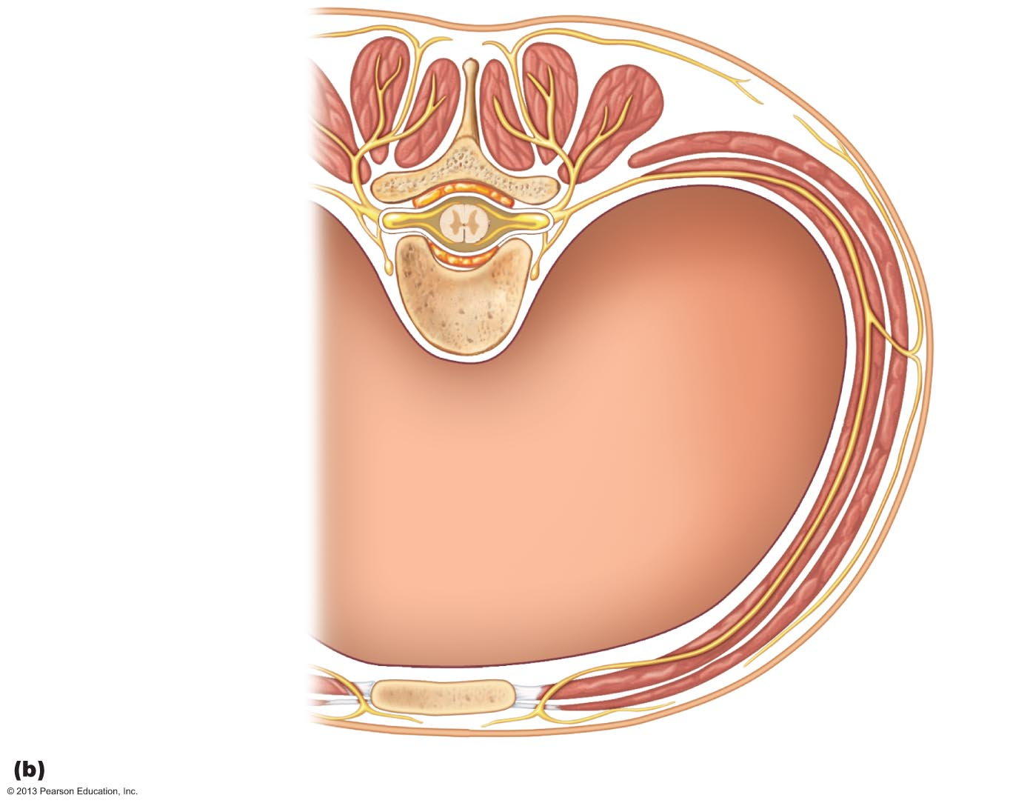
Figure 13.8b Formation of spinal nerves and rami distribution.
Dorsal ramus
Ventral ramus
Spinal nerve
Rami communicantes
Sympathetic trunk
ganglion
Intercostal nerve
Dorsal root ganglion
Dorsal root
Ventral root
Branches of intercostal nerve
Lateral cutaneous
Anterior cutaneous
Sternum
Cross section of thorax showing the main roots and branches of a spinal nerve.

Slide 12
Cervical Plexus and the Neck
Formed by ventral rami of C₁–C₄
Most branches form cutaneous nerves
  Innervate skin of neck, ear, back of head, and shoulders
  Other branches innervate neck muscles
Phrenic nerve
  Major motor and sensory nerve of diaphragm (receives fibers from C₃–C₅)
  Irritation → hiccups

Slide 13
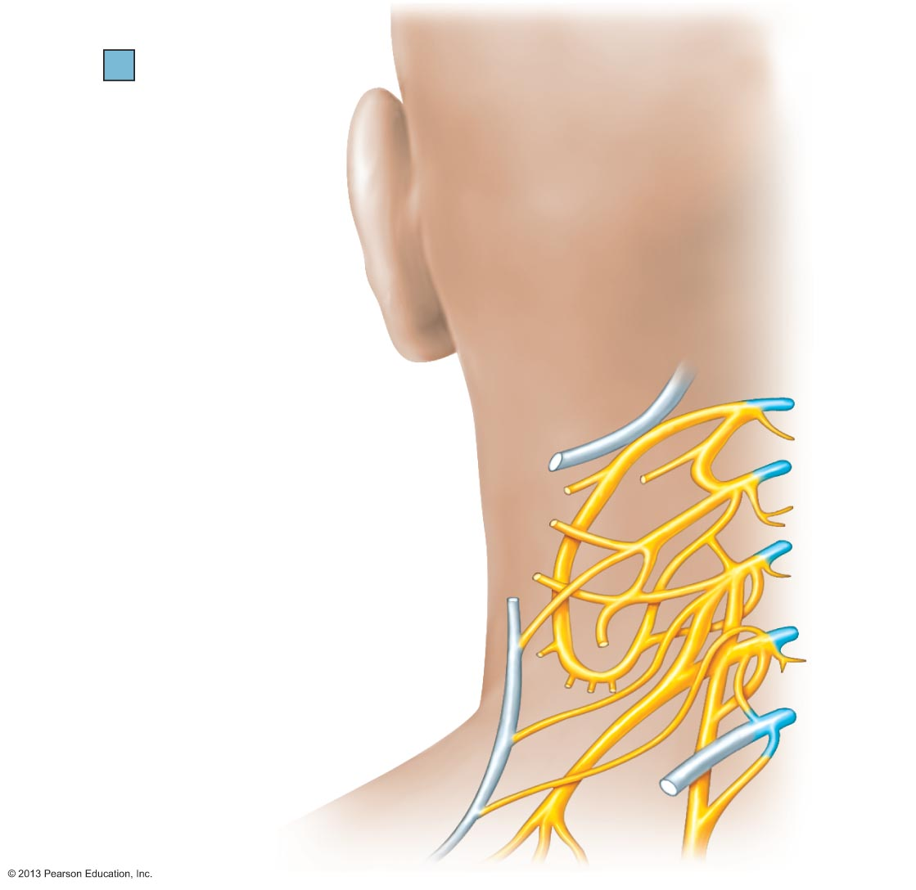
Figure 13.9 The cervical plexus.
Ventral rami
Segmental
branches
Hypoglossal
nerve (XII)
Ventral
rami:
Lesser occipital
nerve
C₁
Greater auricular
nerve
C₂
Transverse
cervical nerve
C₃
Ansa cervicalis
C₄
Accessory nerve (XI)
Phrenic nerve
C₅
Supraclavicular
nerves

Slide 14
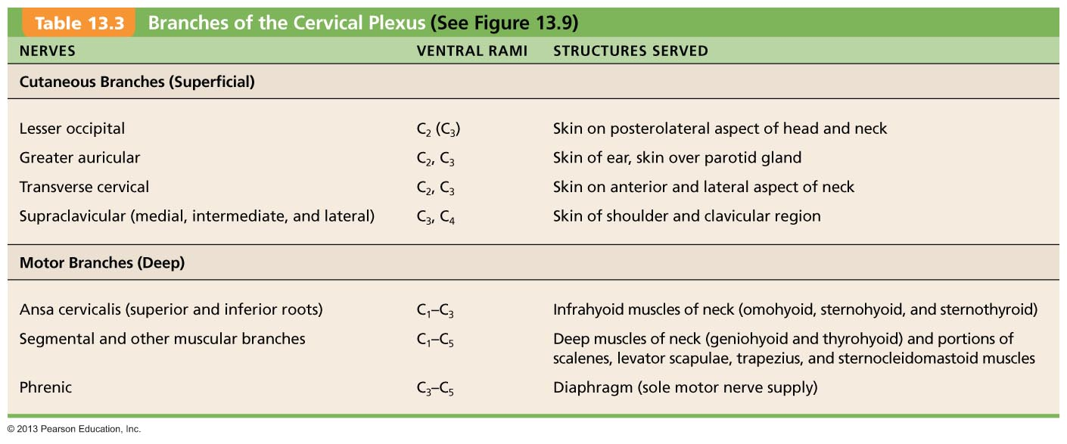
Table 13.3 Branches of the Cervical Plexus

Slide 15
Brachial Plexus and Upper Limb
Formed by ventral rami of C₅–C₈ and T₁ (and often C₄ and/or T₂)
Gives rise to nerves that innervate upper limb
Major branches of this plexus:
  Roots—five ventral rami (C₅–T₁), which form
  Trunks—upper, middle, and lower, which form
  Divisions—anterior and posterior, which form
  Cords—lateral, medial, and posterior

Slide 16
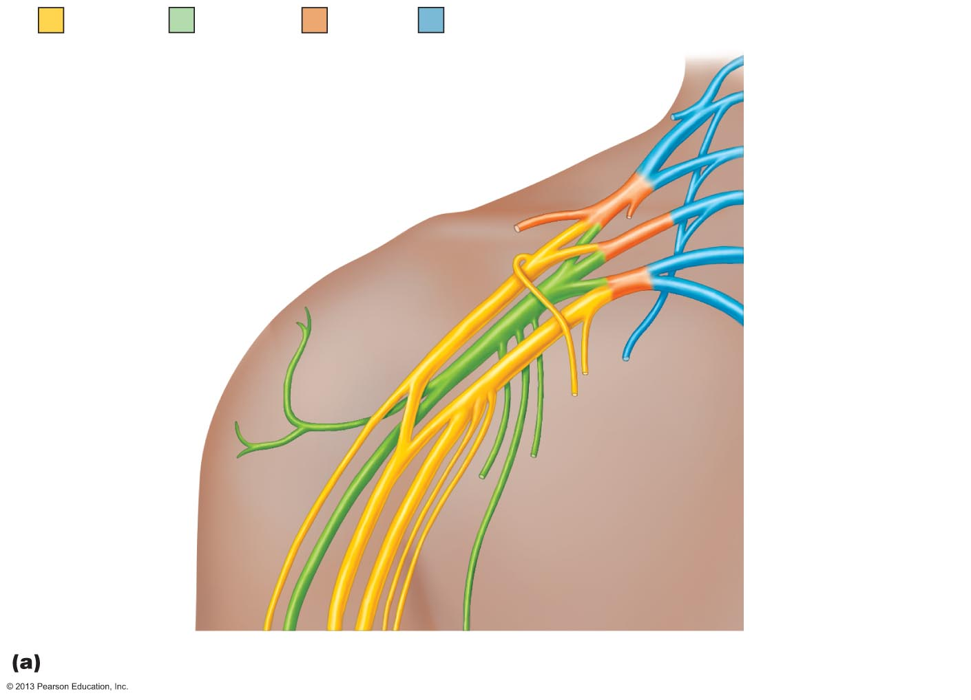
Figure 13.10a The brachial plexus.
Anterior
divisions
Posterior
divisions
Trunks
Roots
Roots (ventral rami):
C₄
Dorsal scapular
C₅
Nerve to
subclavius
Suprascapular
C₆
Upper
Posterior
divisions
C₇
Middle
Trunks
Lateral
C₈
Lower
Cords
Posterior
T₁
Long thoracic
Medial
Medial pectoral
Lateral pectoral
Axillary
Upper subscapular
Musculo-
cutaneous
Lower subscapular
Radial
Thoracodorsal
Median
Medial cutaneous
nerves of the arm
and forearm
Ulnar
Roots (rami C₅–T₁), trunks, divisions, and cords

Slide 17
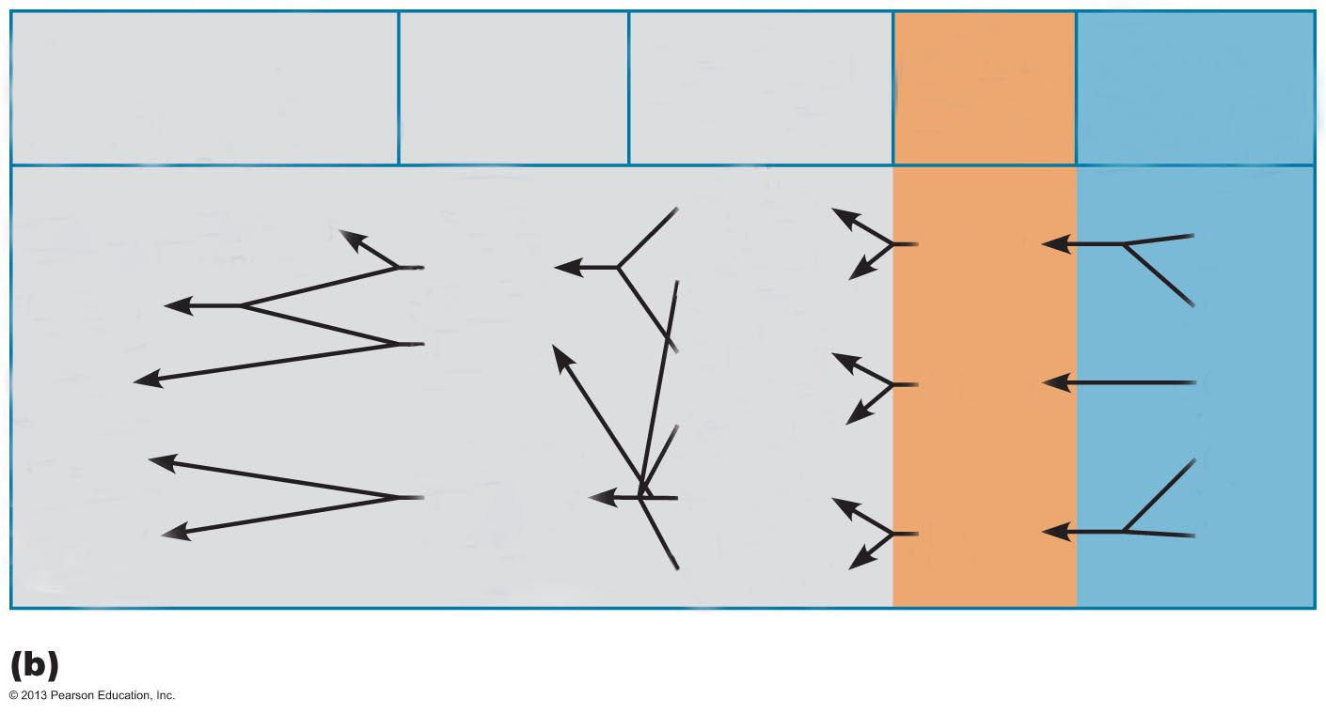
Figure 13.10b The brachial plexus.
Major terminal
branches
(peripheral nerves)
Roots
(ventral
rami)
Cords
Divisions
Trunks
Musculocutaneous
Anterior
Upper
C₅
Lateral
Posterior
Median
C₆
Medial
Anterior
Ulnar
Middle
C₇
Posterior
Radial
C₈
Posterior
Anterior
Axillary
Lower
T₁
Posterior
Flowchart summarizing relationships within the brachial plexus

Slide 18
Brachial Plexus: Five Important Nerves
Axillary—innervates deltoid, teres minor, and skin and joint capsule of shoulder
Musculocutaneous—innervates biceps brachii and brachialis, coracobrachialis, and skin of lateral forearm
Median—innervates skin, most flexors, forearm pronators, wrist and finger flexors, thumb opposition muscles
Ulnar—supplies flexor carpi ulnaris, part of flexor digitorum profundus, most intrinsic hand muscles, skin of medial aspect of hand, wrist/finger flexion
Radial—innervates essentially all extensor muscles, supinators, and posterior skin of limb

Slide 19
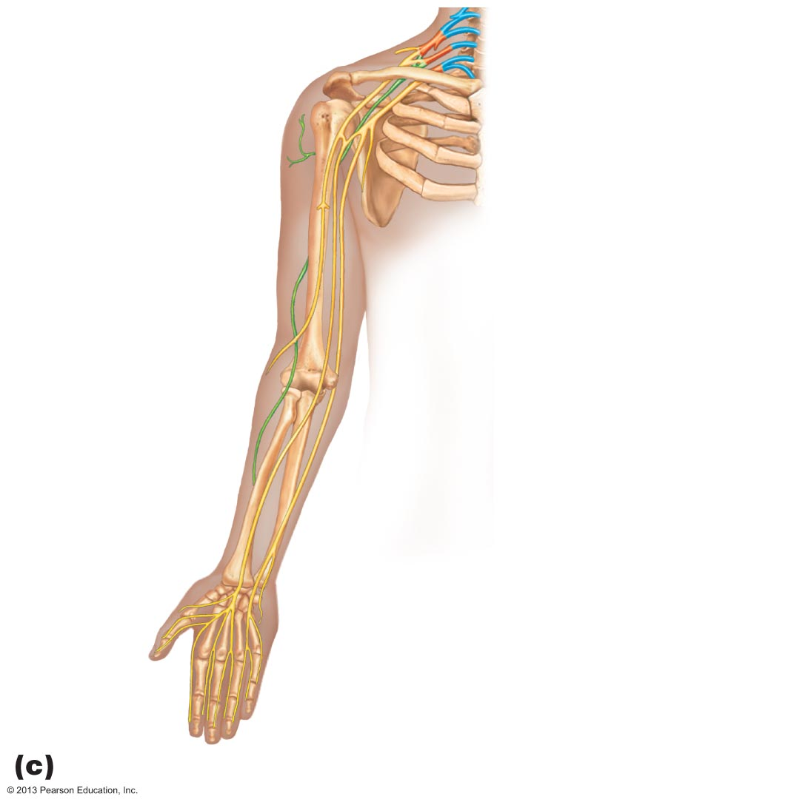
Figure 13.10c The brachial plexus.
Axillary nerve
Humerus
Radial nerve
Musculocutaneous nerve
Ulna
Radius
Ulnar nerve
Median nerve
Radial nerve (superficial branch)
Dorsal branch of ulnar nerve
Superficial branch of ulnar nerve
Digital branch of ulnar nerve
Muscular branch
Digital branch
Median nerve
The major nerves of the upper limb

Slide 20
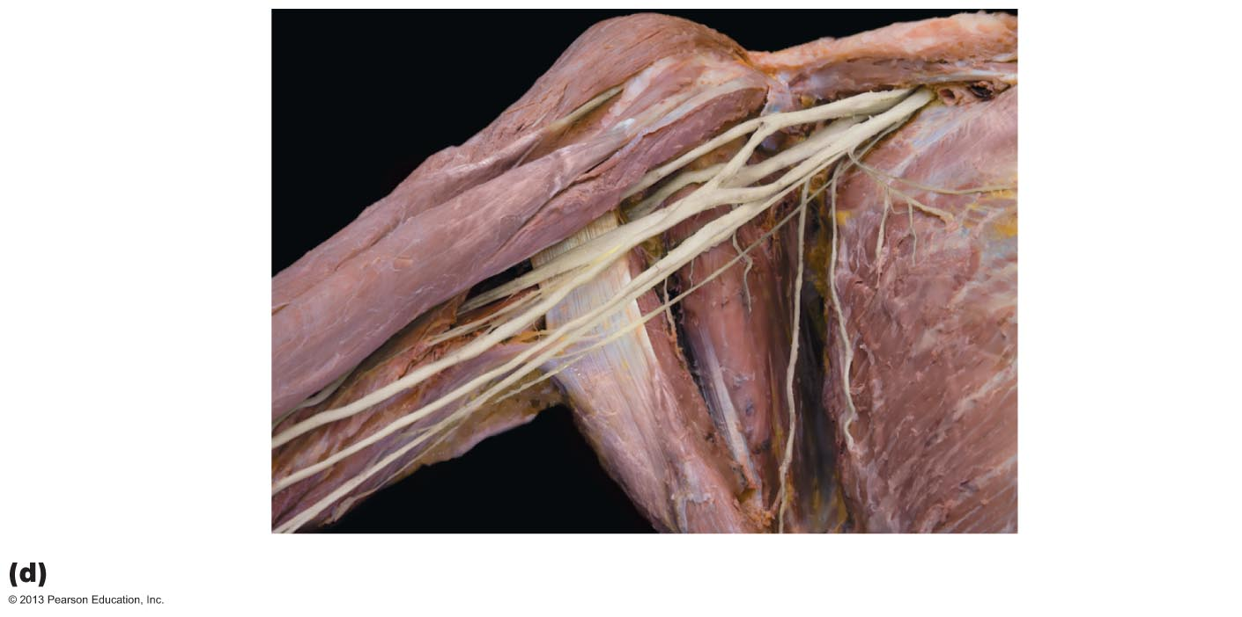
Figure 13.10d The brachial plexus.
Musculocutaneous
nerve
Lateral cord
Posterior cord
Axillary nerve
Medial cord
Radial nerve
Median nerve
Ulnar nerve
Cadaver photo

Slide 21
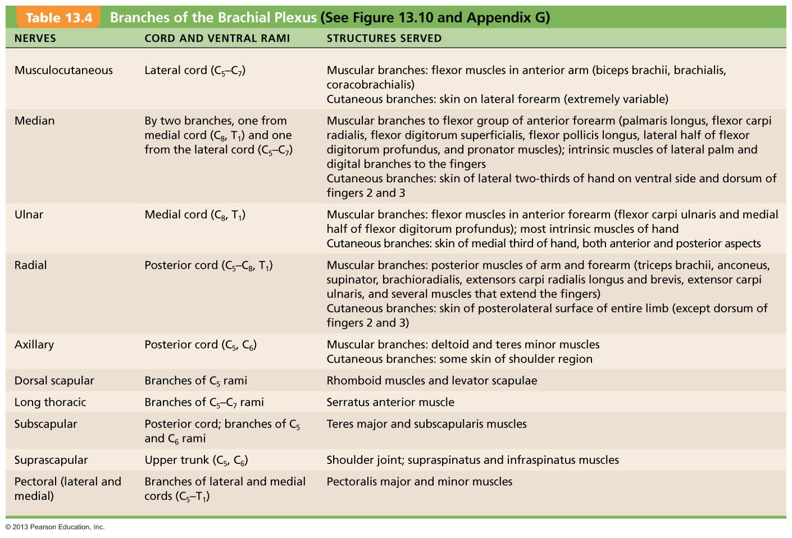
Table 13.4 Branches of the Brachial Plexus

Slide 22
Lumbar Plexus
Arises from L₁–L₄
Innervates thigh, abdominal wall, and psoas muscle
Femoral nerve—innervates quadriceps and skin of anterior thigh and medial surface of leg
Obturator nerve—passes through obturator foramen to innervate adductor muscles

Slide 23
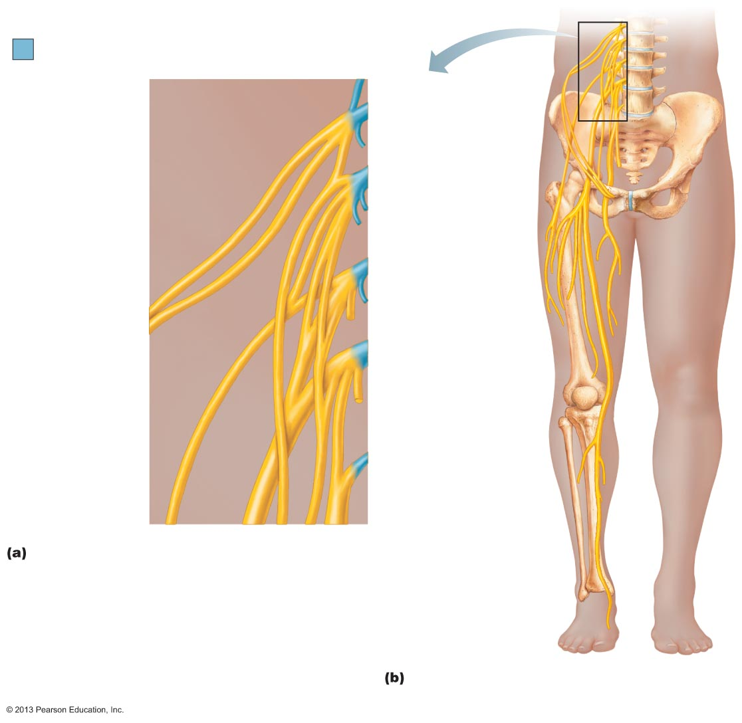
Figure 13.11 The lumbar plexus.
Ventral rami
Ventral
rami:
L₁
Iliohypogastric
Ilioinguinal
L₂
Femoral
Iliohypogastric
Ilioinguinal
Lateral
femoral
cutaneous
Genitofemoral
L₃
Obturator
Lateral femoral
cutaneous
Anterior
femoral
cutaneous
L₄
Saphenous
Obturator
Femoral
L₅
Lumbosacral
trunk
Ventral rami and major branches of the lumbar plexus
Distribution of the major nerves from the
lumbar plexus to the lower limb

Slide 24
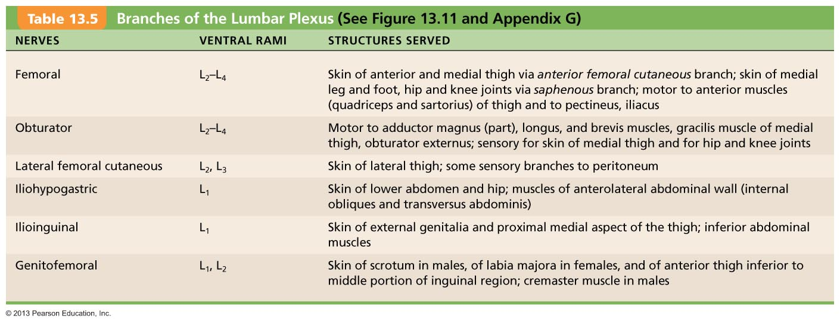
Table 13.5 Branches of the Lumbar Plexus

Slide 25
Sacral Plexus
Arises from L₄–S₄
Serves the buttock, lower limb, pelvic structures, and perineum
Sciatic nerve
  Longest and thickest nerve of body
  Innervates hamstring muscles, adductor magnus, and most muscles in leg and foot
  Composed of two nerves: tibial and common fibular

Slide 26
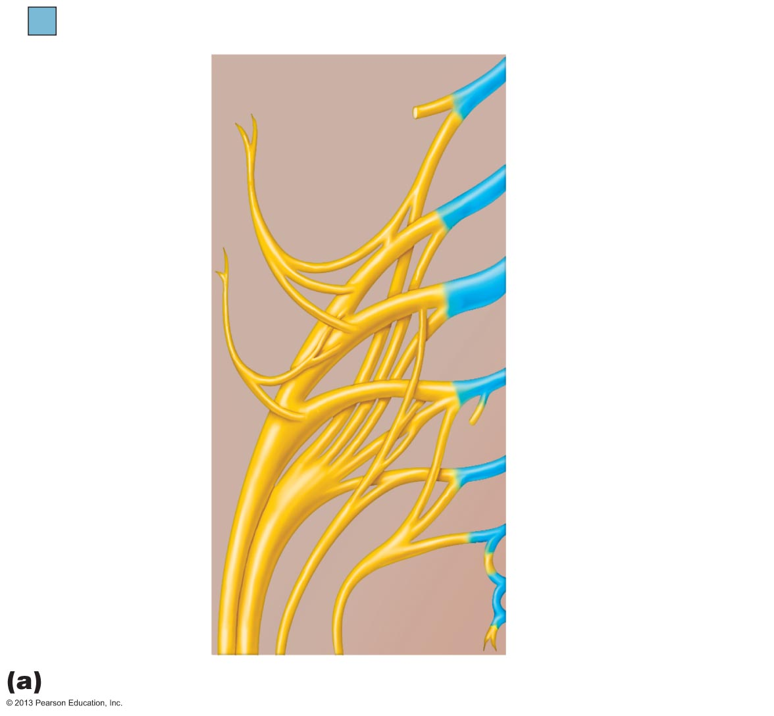
Figure 13.12a The sacral plexus.
Ventral rami
Ventral
rami:
L₄
Superior
gluteal
L₅
Lumbosacral
trunk
S₁
Inferior
gluteal
S₂
Common
fibular
Tibial
S₃
Posterior
femoral
cutaneous
S₄
Pudendal
S₅
Sciatic
Co₁
Ventral rami and major branches of the sacral plexus

Slide 27
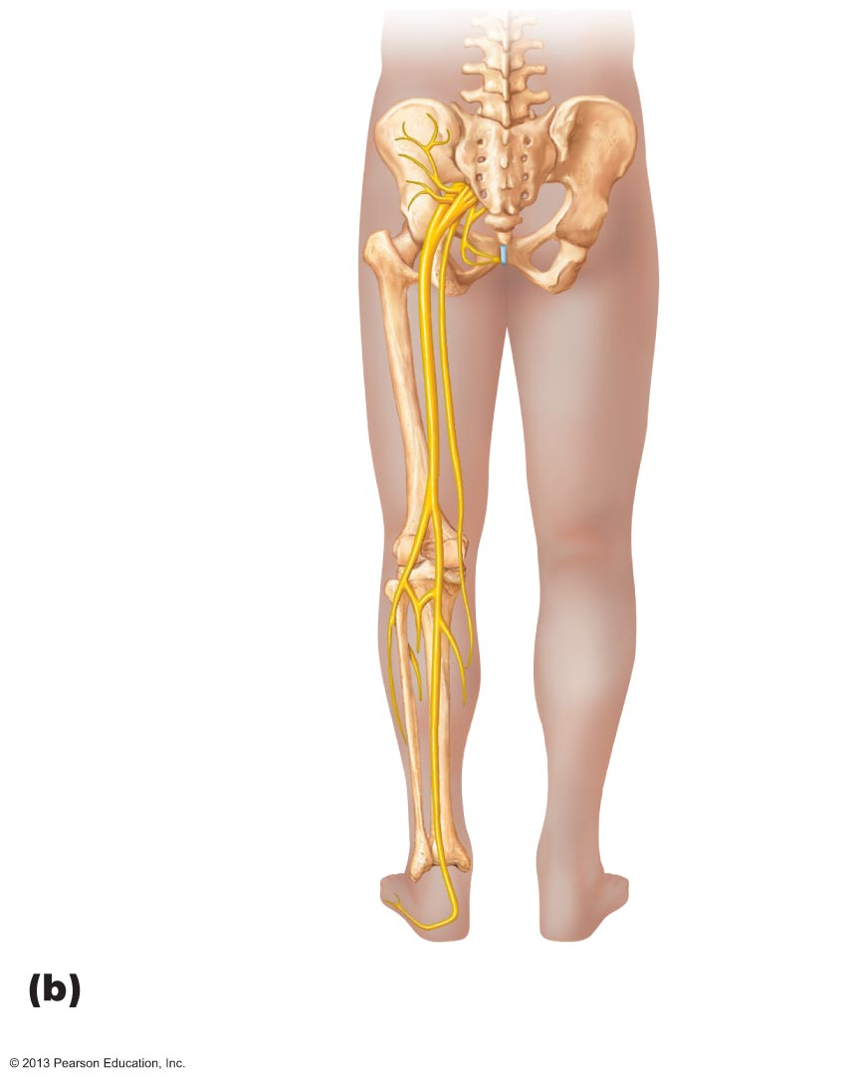
Figure 13.12b The sacral plexus.
Superior gluteal
Inferior gluteal
Pudendal
Sciatic
Posterior femoral
cutaneous
Common fibular
Tibial
Sural (cut)
Deep fibular
Superficial fibular
Plantar branches
Distribution of the major nerves from
the sacral plexus to the lower limb

Slide 28
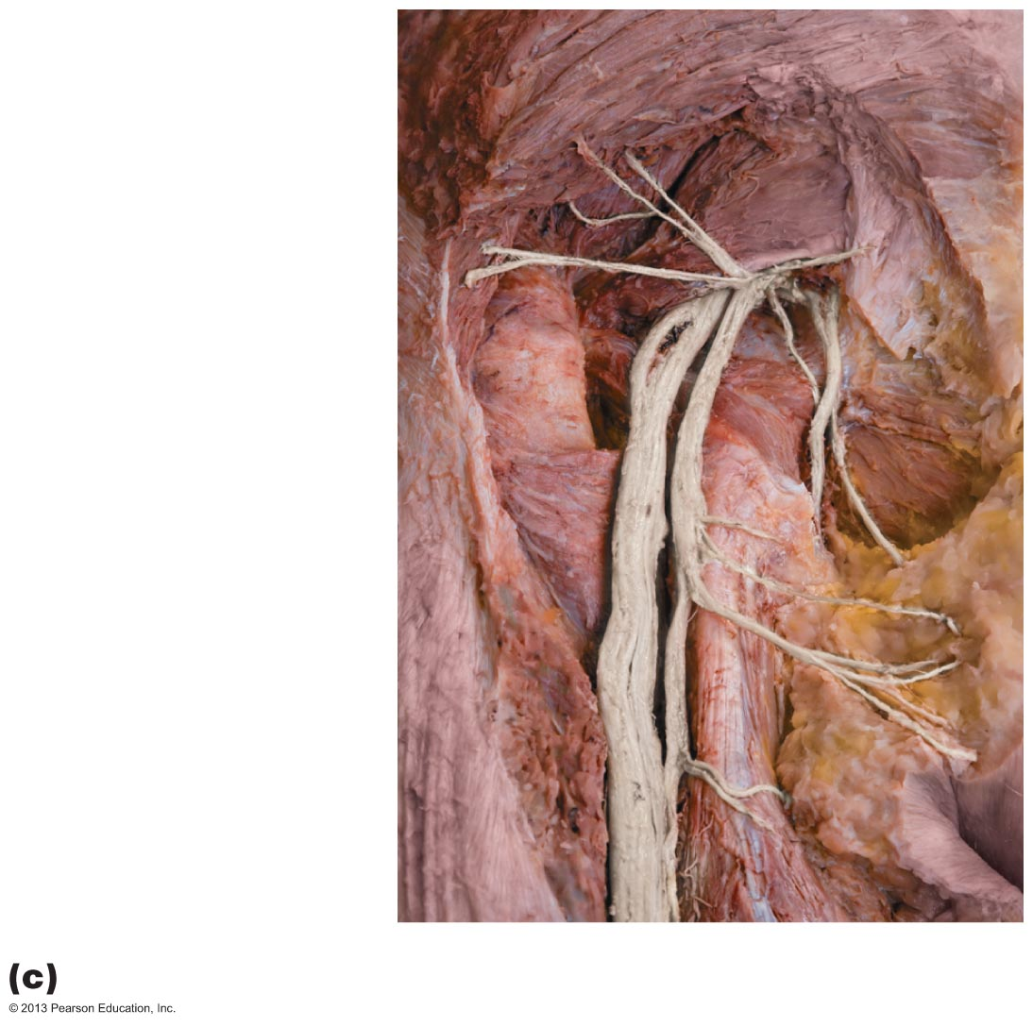
Figure 13.12c The sacral plexus.
Gluteus maximus
Piriformis
Inferior gluteal
nerve
Common fibular
nerve
Tibial nerve
Pudendal nerve
Posterior femoral
cutaneous nerve
Sciatic nerve
Cadaver photo

Slide 29
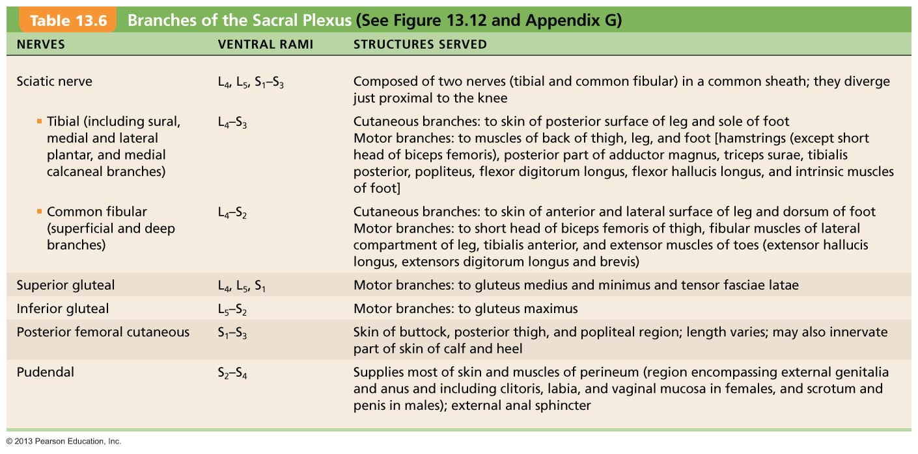
Table 13.6 Branches of the Sacral Plexus

Slide 30
Anterolateral Thorax and Abdominal Wall
Ventral rami in thorax in simple segmental pattern
  Form intercostal nerves that supply intercostal muscles, muscle and skin of anterolateral thorax, most abdominal wall
  Give off cutaneous branches to skin along course
Dorsal rami innervate posterior body trunk

Slide 31
Innervation of Skin: Dermatomes
Dermatome - area of skin innervated by cutaneous branches of single spinal nerve
All spinal nerves except C₁ participate in dermatomes
Extent of spinal cord injuries ascertained by affected dermatomes
Most dermatomes overlap, so destruction of a single spinal nerve will not cause complete numbness

Slide 32
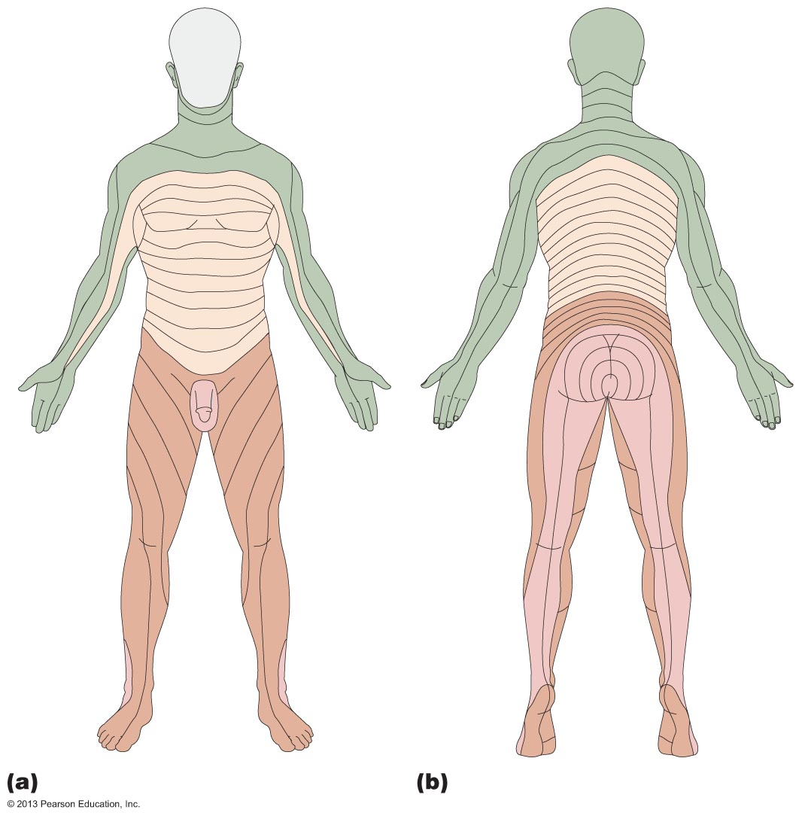
Figure 13.13 Map of dermatomes.
C2
C2
C3
C4
C3
C5
C6
C4
C7
C8
C5
T1
C5
T1
T2
T2
T3
T3
T4
T2
T4
T5
T2
T6
T5
T7
T6
T8
T9
T7
C6
T10
C6
C5
T8
C5
T11
T9
C7
T12
C7
C6
T10
C6
C8
L2
S1
L1
C8
T11
S2
L3
T12
L4
S3
L5
C6
L1
L1
C6
S4
C7
S2
C7
S5
C8
L2
S3
L2
C8
S1
S2
S2
S1
L3
L3
L1
L5
L2
L5
L4
L4
L5
L5
L3
L4
S1
S1
L4
L4
L5
L5
S1
Anterior view
Posterior view

Slide 33
Innervation of Joints
To remember which nerves serve which synovial joint
  Hilton's law: Any nerve serving a muscle that produces movement at joint also innervates joint and skin over joint

